Slide 1
Norbu Stress Control
CR analysis

Slide 2
Norbu - Introduction
Norbu Stress Control is the first anti-stress app that teaches to manage stress and emotions on the physical level.
Anxiety relief games, breathing exercises and guided meditations help to develop stress-control habits. “5-days unlock Premium for free” feature makes these premium exercises available for those who really need them for no cost.
Norbu app has guided meditations and antistress trainings. The exercises are very simple and safe. Anyone can do it. You can meditate and breathe with a guide or in silence.

Slide 3
Current problem
Low CR in payment.
What is the best mechanism (tariff schema) for switching from the free version to paid one to make it convenient for the user, and at the same time increase the payment or increase the duration of use of free version?

Slide 4
Questions
How does the cost affect returns of clients?
What may increase retention rate?
What are the optimal prices for optimal retention?
Are there any target audiences that we are missing?

Slide 5
Considering the size of the data , March 4,2022 to Apr 4,2022 data is used for most of our analysis..

Slide 6
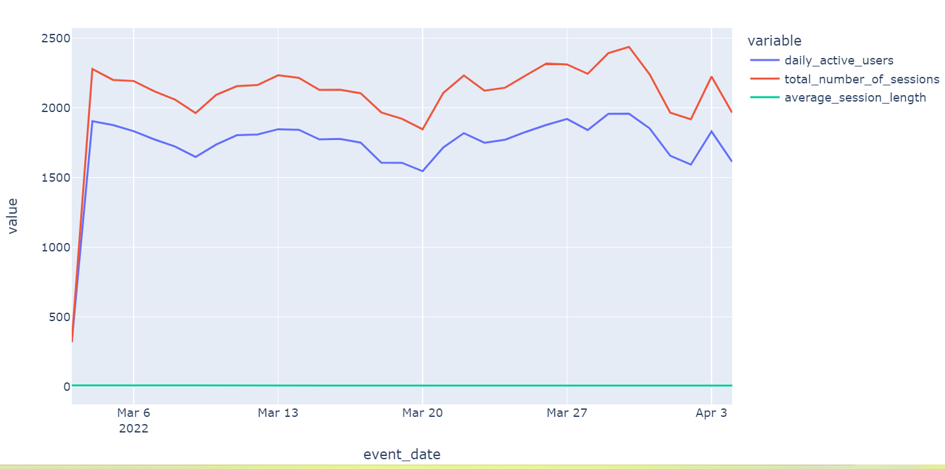
Session details

Slide 7
Session details
The average session length is around 7-8minutes consistently for most of the sessions..
Daily Active Users and total number of sessions shows that most of the users have only 1 session per day .

Slide 8
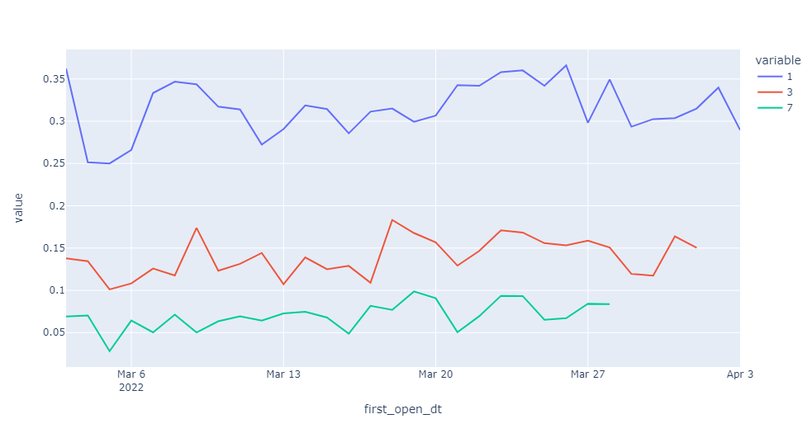
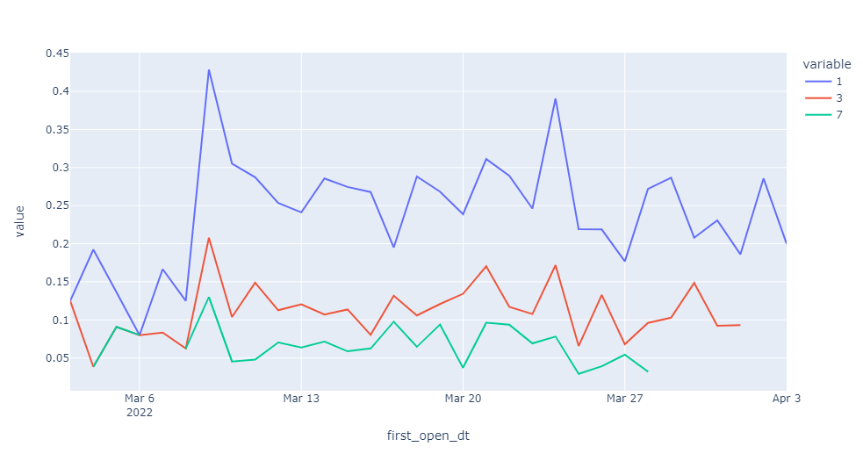
1,3,7 day retention rate - first open
ANDROID
IOS

Slide 9
1,3,7 day retention rate - first open
Though IOS retention has some spikes at some point ,
in general it is lower than Android retention rate.
IOS 7day retention rate is lowering towards the end of the
analysis period.
3 day and 7 day retention of Android users shows some decline.

Slide 10
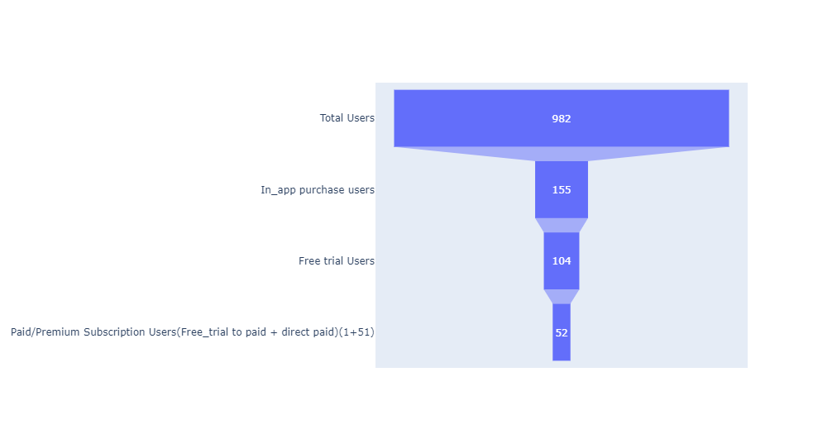
In-App Purchase Event Funnel

Slide 11
In-App Purchase - Event Funnel
Of the total users , only 5% end up in paid subscription .
Around 11% of the total users opt for free trial.
Looking at the users in free trial , only 1 user (less than 1% )go for paid subscription..
Based on all the above data , it is very clear that we have
a very low conversion rate.

Slide 12
Users in free trial
About 84% of the users opt for free_trial within 1-3 minutes of first start time..
More than 50% of the users have used just 2-3 days in a
month in their free trial period.
All the users we have in this free trial are from IOS platform using the product ‘norbu_annual_ios’
One user goes for paid subscription buying the product ‘app.norbu.premium_sale’ of original value 29.99 on sale with value of 17.99usd.

Slide 13
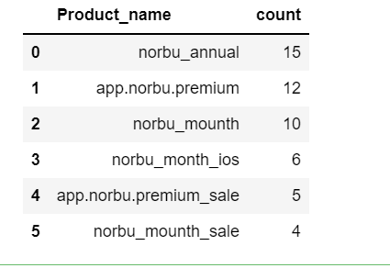
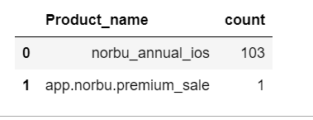
Free trial vs paid users
Free User
Paid User

Slide 14
Paid users
Of the total users , only 5% buy paid subscription.
Around 25% of users go for paid subscription within a day..
Nearly 12-13% of users take more months to become paid subscriber which cannot be ignored..
‘norbu_annual’ ,’app.norbu.premium’,’norbu_mounth’, ‘norbu_month_ios’,’app.norbu.premium_sale’,’norbu_mounth_sale’ are the products bought by paid subscription.
Though in pricy side ,’app.norbu.premium’ is used by more users (30$) as well as on sale for 15-20$.

Slide 15
Paid Users
‘norbu_month’ which is on lower pricing(3-5$)is bought by few users especially in IOS platform.
To sum up , ‘app.norbu_premium’ can be offered with some sale (15-20$) and also with more added features initially..
Also ‘norbu_month’ can be upgraded and promoted with the same price range with added features.

Slide 16
Conclusion with Answers
Based on all the above points , changes need to be made for IOS as IOS retention is lesser compared to Android and also conversion rate from free to paid user is way lesser..
Since users are not fully using free trial period, changes should be made in norbu_annual_ios (more features should be added to attract users ) which is used in free_trial or try changing the product in free trial version.

Slide 17
Conclusion with Answers
Product features along with Cost does affect the clients .
More features can be added to different products especially those in free trial to attract customers to try free trial period fully.
'app.norbu.premium' is the product bought by more users though it is pricier.(20-30) and also when sales(15-20 )
To attract more users , we can offer more added features in 'app.norbu.premium' in the price range (15-20$) especially for ANDROID users.

Slide 18
Conclusion with Answers
'norbu_month' can be promoted by increasing the features available within the same price range(3-5$).
Since we don’t see major impact of increased free trial duration , will try other way increasing features with gradual increase in price later..
More features with less price might be a better combination to try with..
Making all these changes will positively impact retention rate and conversion rate in the future..

Slide 19
THE END

